Slide 1
Sensing and Planning
Notes:
Moving on to sensing and planning…
This section of our research is concerned mainly with interpreting the print environment and developing a plan for controlling the manipulator and the extruder through the print.

Slide 2
3D Scanning
Surface Data
Collision Avoidance
Toolpath Planning
Notes:
In order to print into a priori-unknown environment. The printer must have information about its surface. This will help to avoid collisions and provide data on how to algorithmically create a suitable toolpath for manufacturing and navigation.
The primary types of scanners we would like to explore are ranging scanners, triangulation scanners, and tactile scanners. Ranging scanners are time-of-flight based and may be unsuitable for close-range scanning. However, they are comparatively simple with regards to deployment and noise. Triangulation scanners take advantage of the known geometry of the laser emitter and the camera. In contrast to ranging scanners, they are suitable for close-range scans but susceptible to noise. Tactile sensing is a scanning method that would be isolated to an environment that is insensitive to physical interaction (environments that are excluded are those with electronics or loose or moving parts). However, they provide a method for edge detection that is vital to computing edges and boundaries for generating a toolpath. The print head must be aware of its environment
Avoiding collisions
Basis for developing a suitable toolpath
Ranging Scans
Time-of-flight based
Laser Triangulation
Uses geometry of known locations of laser emitter and camera
Tactile Sensing
Thin sheets of force-sensitive resistors
The first step toward planning a toolpath is obtaining the surface data of the print. The data should allow us to perform collision avoidance algorithms and prepare a toolpath plan that is suitable for the topology of the surface.

Slide 3
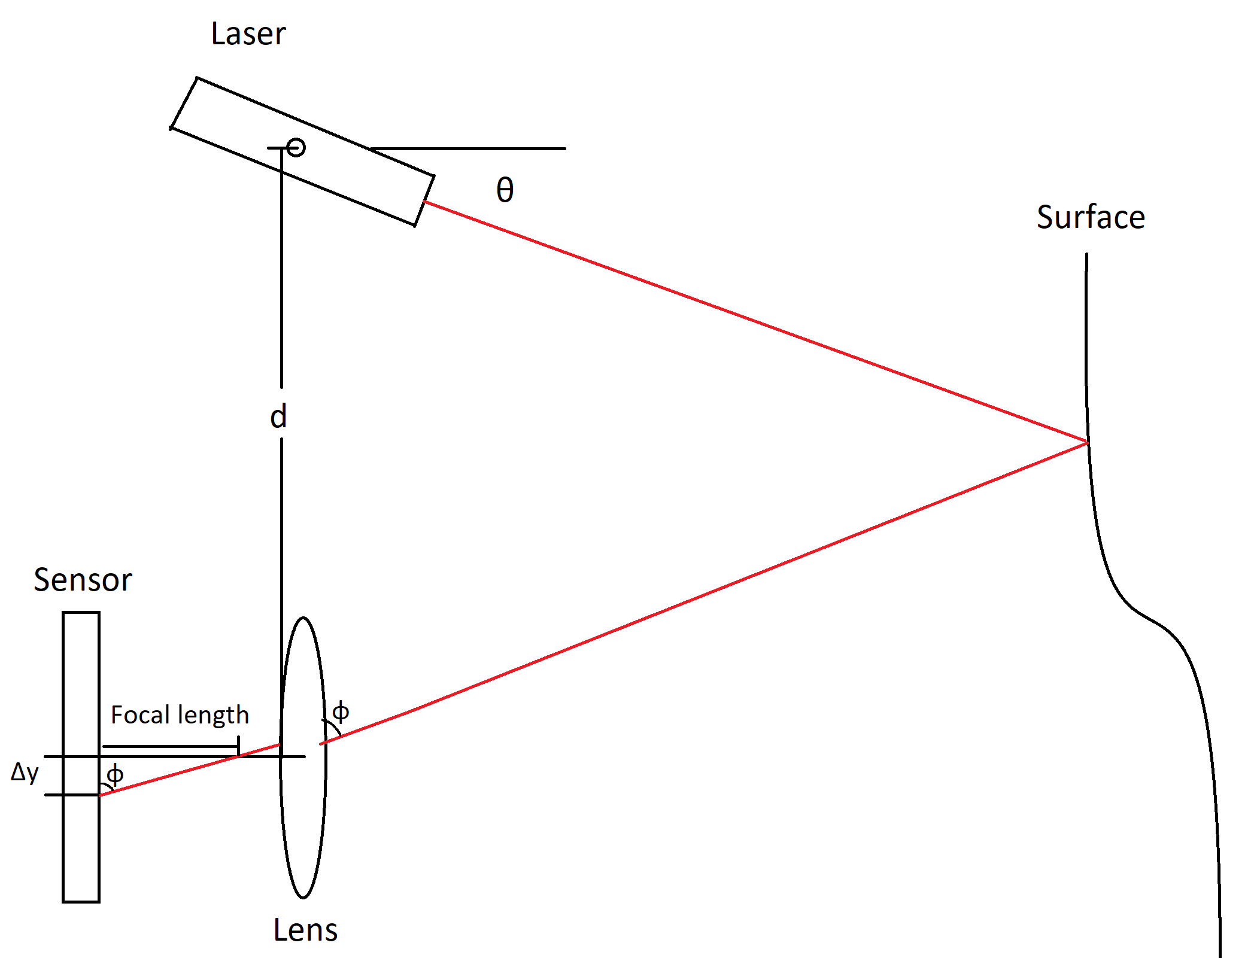
Scanning Methods
LIDAR based time-of-flight
Laser Triangulation
Tactile Sensing
Notes:
Boehler et al. notes that close-range time-of-flight scanning instruments may have errors in the range of some millimeters [27]. Considering that commercial 3D printers offer nozzle sizes in the range of tenths of millimeters, error of this magnitude is undesirable as this would cause misalignment or overall failure over multiple layers. An implementation of in situ printing utilizing ranging techniques would require additional consideration of the suitable print profile and improved filtering methods (discussed below).
Talk about noise
There are various scanning methods that can be used to obtain this surface data. The choices are time-of-flight scanning, laser triangulation, and tactile sensing. In our review of current research, it appears that time-of-flight based scanning is unsuitable for close-range tasks as it produces error in the range of tenths of millimeters. Error in this range can cause noticeable effects in the quality of printed layers as the extrusion profile is typically in the range of tenths of millimeters as well [27].
Tactile sensing is a secondary method of scanning that we briefly looked into in our review. Unlike laser point cloud scanning, tactile sensing directly offers the ability to detect boundaries and edges. This could be useful for the planning algorithm and would not require further processing.
[27] W. Boehler and A. Marbs, “3D Scanning Instruments,” Proc. CIPA WG, pp. 9–18, 2002.

Slide 4
Planning
Algorithms for:
Collision Avoidance
Toolpath Generation
Notes:
Once the surface data is obtained and prepared for analysis, we can move on to developing a toolpath for the environment. Any such toolpaths would have to take into account self-collision and print collisions. We would also like to have toolpath generation be generalizable to most concave topologies so a general algorithm would ideally be developed.

Slide 5
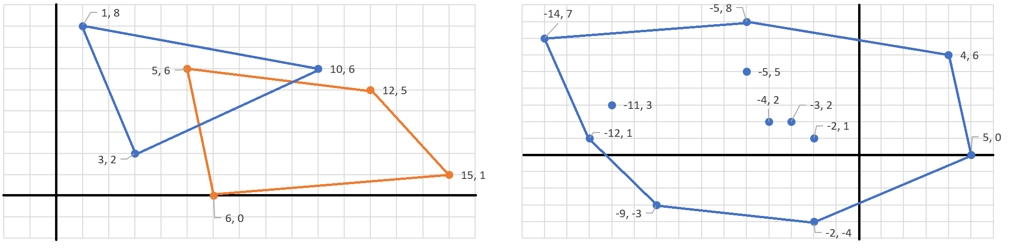
Planning
Toolpath generation
Iso-curves
Rain-trapping algorithm
Collision Avoidance via Oriented Bounding Boxes
Two Convex Polygons
Minkowski Difference
Notes:
In our review of current research, a tested method of topological analysis and slicing is the usage of iso-curves [3]. This method takes a projection of the surface and reproduces layers resembling the surface upwards to create the layer spaces. A print object could then be created using an AND operation between the point clouds of the object and the projected layers, effectively producing the sliced toolpath.
An alternate method may be to resort to non-conformal printing and implement what’s known as the rain-trapping algorithm in computer science. This algorithm determines local minimums given a surface in 3D space and provides a method for locating the necessary points at which material extrusion is needed.
[3] N. Bausch, D. P. Dawkins, R. Frei, and S. Klein, “3D Printing onto Unknown Uneven Surfaces**This work is supported by the University of Portsmouth – Research Development Framework (RDF) 2015.,” IFAC-Pap., vol. 49, no. 21, pp. 583–590, Jan. 2016, doi: 10.1016/j.ifacol.2016.10.664.

Slide 6
methodology

Slide 7
Software
Data Pipelining
Software-side Filtering
Algorithm Implementation
Manipulator Control
Notes:
Most of sensing and planning requirements can be tested and demonstrated independently of the other subteams through software. The corresponding tasks involve data pipelining between the hardware and data manipulation scripts. We can also perform filtering on our data using the open source Point Cloud Library package.

Slide 8
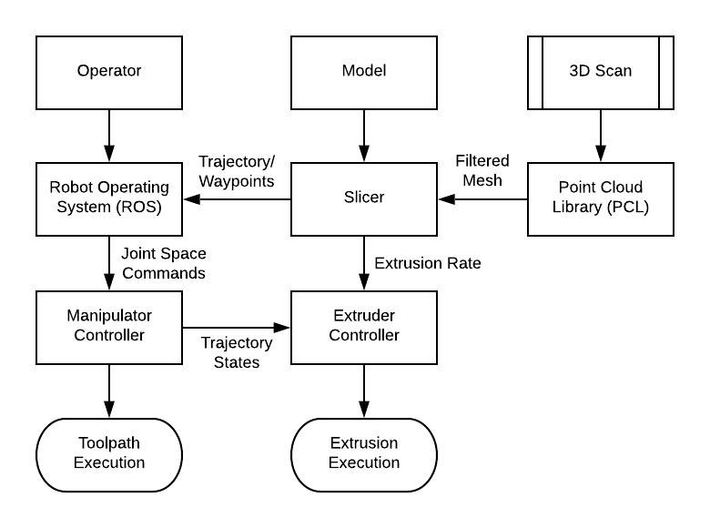
Logical Block Diagram for Information Flow
Notes:
Here is the logical block diagram for our system.

Slide 9
Testing
Manipulator Control in Simulation
Scanning Feedback
Filtering Configurations and Optimization
Testing for minimum resolution
Toolpath Generation in Simulation
Notes:
We’ll test the data qualitatively by comparing the returned point cloud surface with the actual surface of a scan. Algorithm implementation and manipulator control can be done in simulation in ROS. Most of these criteria can be determined successful simply by pass/fail. The point cloud surface filtering will be successful if it can limit errors to around hundredths of a mm - this would imply a maximum 10% error for each printed layer.

Slide 10
Timeline
Fall 2019
Design or buy an extruder head
Determine robotic arm/3D printer
Compare scanning options
Spring 2020
Determine detailed budget
Test 3D scanning options
Design extruders and extruder mount
Fall 2020
Begin integrating different systems
Create Toolpathing algorithms
Spring 2021
Minimum viable product integrated and tested
Results and findings written to thesis
Fall 2021
Research into features and suspended voids
Robustness testing
Spring 2022
Results prepared for presentation
New features and future work prepared

Slide 11
Bibliography

